Slide 1

Physics teacher education:
An international conversation
Dr. Carl J. Wenning
Physics Department
Illinois State University
Normal, IL U.S.A.

Slide 2
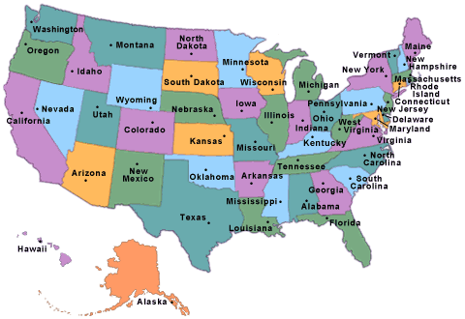
Physics Teacher Education at ISU
One of four sequences within the department:
  Physics
  Engineering physics
  Computational physics
  Physics teacher education
Key personnel:
  Kenneth Wester, Director (2008-present)
  Carl J. Wenning, Director (1994-2008)
National (NCATE) and state accreditation

Slide 3
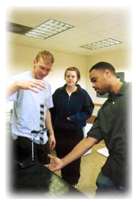
PTE Plan of Study
Broad field science preparation model
Science teachers - Physics designation
Physics teacher education major:
  25 sem hrs of physics content courses
  12 sem hrs of physics teaching methods
  18 sem hrs of astro, chem, geo, and bio
  15 sem hrs of professional education courses
  3 mathematics and 14 general education courses
  50 days of student teaching
  100 hours of clinical experiences

Slide 4
Science Content Courses & Math
107 - Frontiers in Physics
110-112 – Physics for Science and Engineering I-III
205 – Origin of the Universe
217 – Mathematical Methods of Physics
220 – Mechanics I
240 – Electricity & Magnetism I
270 – Adv. Lab I
370 – Adv. Lab II
Physics Methods
Biology, Chemistry, and Earth Science
Calculus I-III

Slide 5
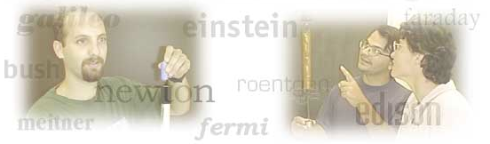
Physics Teaching Methods Courses
PHY 209 - Intro to Teaching High School Physics
PHY 302 - Computer Applications in HS Physics
PHY 310 - Readings for Teaching High School
PHY 311 - Teaching High School Physics
PHY 312 - Teaching Physics by Inquiry
PHY 353 - Student Teaching Seminar

Slide 6
Notable Aspects of PTE Program
Urban Studies Field Trip (209)
Service Learning Project (209)
Capstone Research Project (302)
Whiteboarding and Socratic Dialogues (310)
Japanese Lesson Study Project (311)
Theory into Practice Project (311)
Nature of Science Case Studies (311, 312)
Social Context Project (353)
STT Effectiveness Reporting System (353)

Slide 7
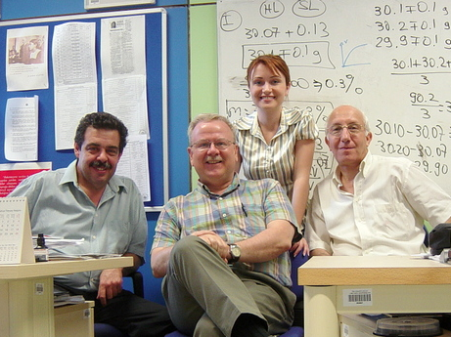
Retention in Teaching Field
75 PTE graduates since 1995
>88% are still in the teaching field
  65 +/- 1 are teaching physics
  1 is a high school principal
  1 in a university teaching profession
  5 not in a teaching profession
  2 unknown

Slide 8

Ongoing Initiatives
Illinois Pipeline Project:
  Teacher booklet
  Student brochure
  Illinois Science Teaching web page
Professional development of in-service teachers
Journal of Physics Teacher Education Online
  Professional Knowledge Standards for All Physics Teacher Educators
  Articles that are the beginnings of a PTE textbook

Slide 9
Primary PTE Emphases
Knowledge Base (content and pedagogy)
Inquiry-oriented Instruction
Levels of Inquiry Model of Science Teaching
Modeling Method of Instruction
Real-world Applications
Nature of Science
Teacher Candidate Assessments

Slide 10
Inquiry-Oriented Instruction
Experiences with Inquiry (PHY 110, 111, 112)
Introducing Inquiry (PHY 209, 302)
Modeling Inquiry (PHY 302, 310)
Promoting Inquiry (PHY 310, 311)
Developing Inquiry (PHY 302, 311)
Practicing Inquiry (PHY 311, 312)
Deploying Inquiry (STT 399.72)
Supporting Inquiry (in-service mentoring)

Slide 11
Levels of Inquiry Method
of Science Teaching will help teachers to systematically teach the knowledge, scientific and intellectual process skills, and dispositions characteristic of someone who is multi-dimensionally science literate.

Slide 12
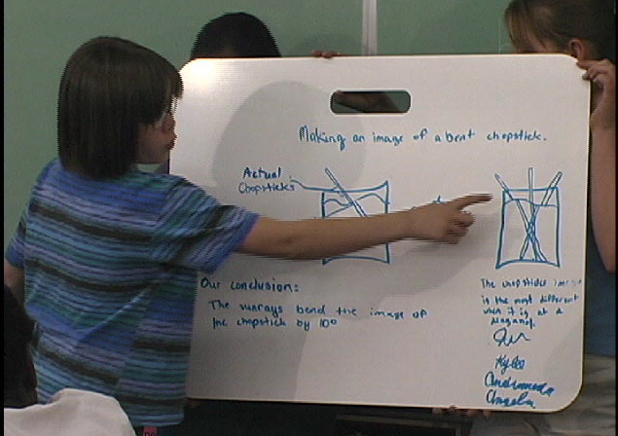
Modeling Method of Instruction
Uses resources of Arizona State University:
  Curriculum guides
  Instructional materials
  Whiteboarding with dialogues
  Multiple representations
Not promoted as the ideal form of inquiry-oriented teaching due to its failure to include real-world applications, social issues, nature of science, history of science, and so on.

Slide 13
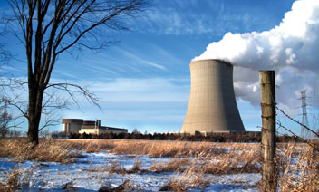

Real-world Applications
Problem-based learning
  Low level nuclear waste dumps
  Nuclear power plant
  Wind farm
  Energy futures
Project-based learning
  Trebuchet
  Rube Goldberg machine

Slide 14
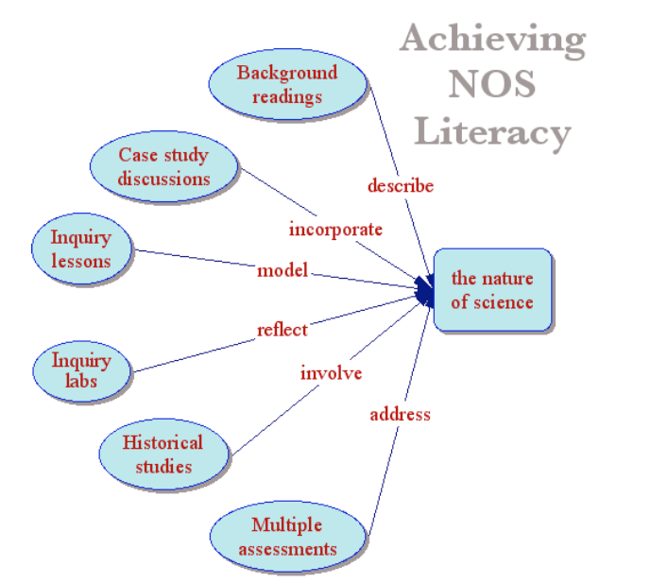
Nature of Science

Slide 15
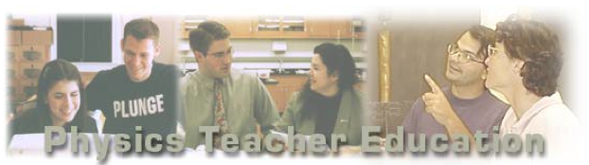
Teacher Candidate Assessments
Assessments are:
  authentic
  continuous
  varied
  multiple
  aligned with standards, objectives, and activities
Course syllabi show these alignments
http://www.phy.ilstu.edu/pte/methods.html

Slide 16
PTE Majors by Year

Slide 17
PTE Graduates by Year

Slide 18
5 ISU Change Principles
an academic leader is needed who is personally committed to improving the teacher preparation process.
an academic leader is needed who deeply understands the teacher preparation process.

Slide 19
Change Principle 3
an academic leader is needed with adequate “release time” for the process of properly educating teacher candidates, for incorporating external standards, and for participating in and providing professional development activities.

Slide 20
Change Principles 4-5
an academic leader is needed who is dedicated to and capable of quality teaching and effectively models it.
a departmental faculty is needed that understands the procedures and worth of the physics teacher education, and supports the efforts of the physics teacher education academic leader.

Slide 21
Extensive Online Resources
There is a massive repository available:
  All course syllabi (undergraduate and graduate)
    Special projects
    Scoring rubrics
    Assessments
  Teacher candidate knowledge base
  Goals and philosophy of teacher preparation
  Conceptual framework
http://www.phy.ilstu.edu/pte/

Slide 22
Additional Resources
Recent publications web page
See especially:
  Change principles for physics teacher education programs
  Development of the physics teacher education program at Illinois State University
  A physics teacher candidate knowledge base

Slide 23
An International Conversation
A program’s description consists of more than a list of courses and a plan of study…
Before I can make recommendations, I need to know more about your program.
Please tell me about your program, and feel free to ask questions about mine.

